Slide 1
P4: Improving the internal design - Chad
Team name: Function;Chaos
Team members: Zach Goodenow, Paul Trapp, Shun Lin, Alber Moied, Martin Hu

Slide 2
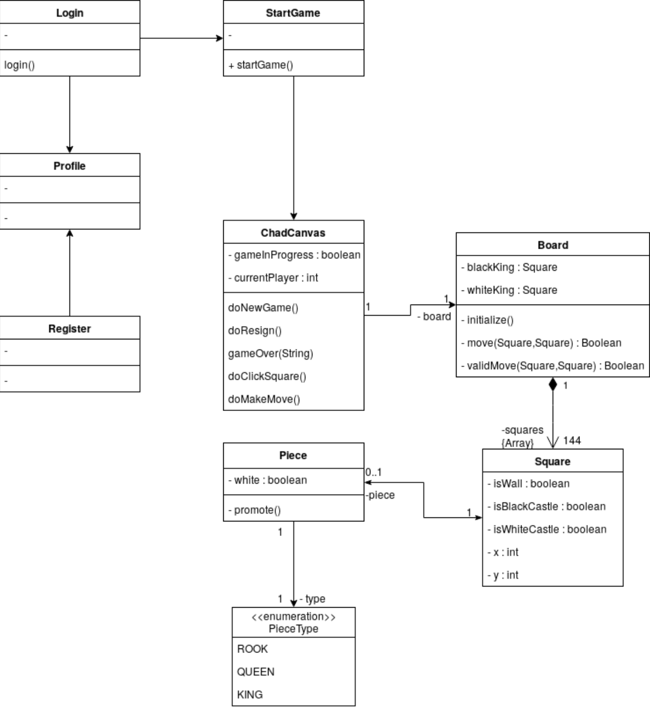
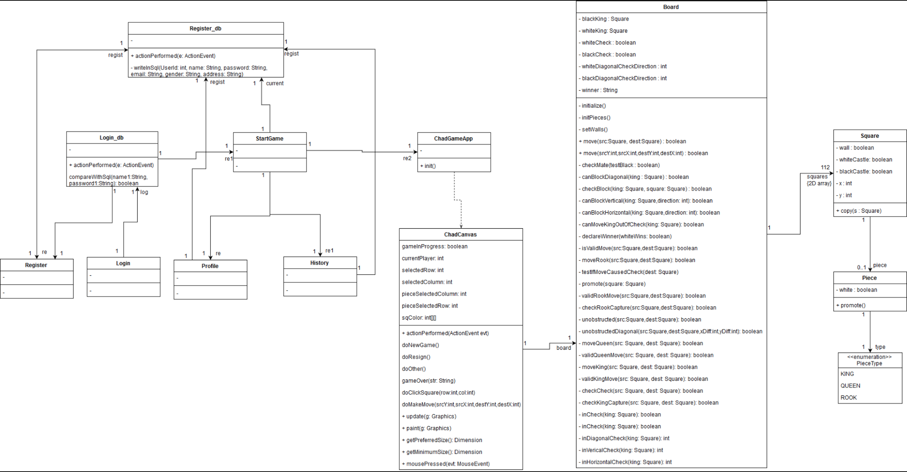
The updated design class diagram
Old
New

Slide 3
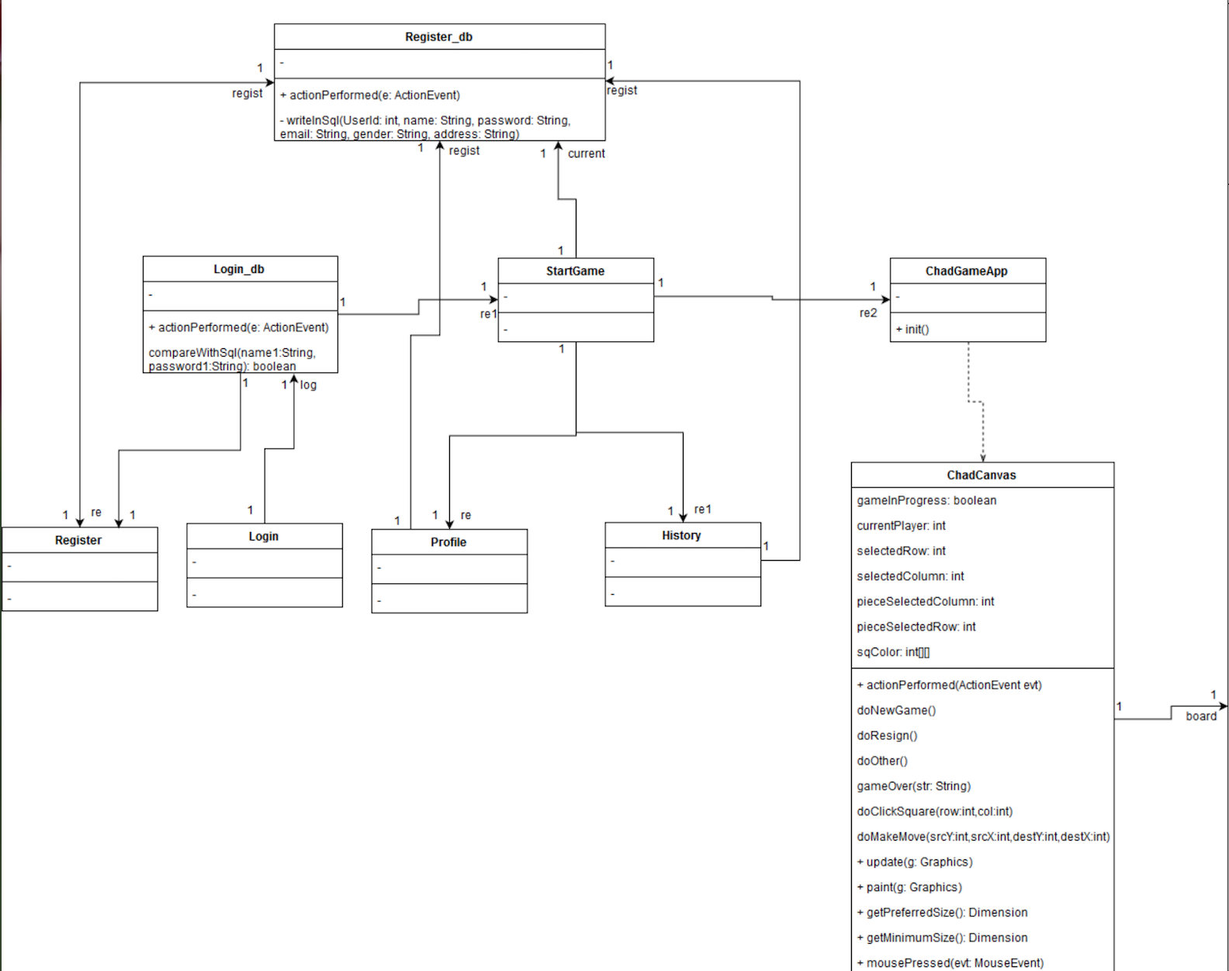
Updated design class diagram (1/2)

Slide 4
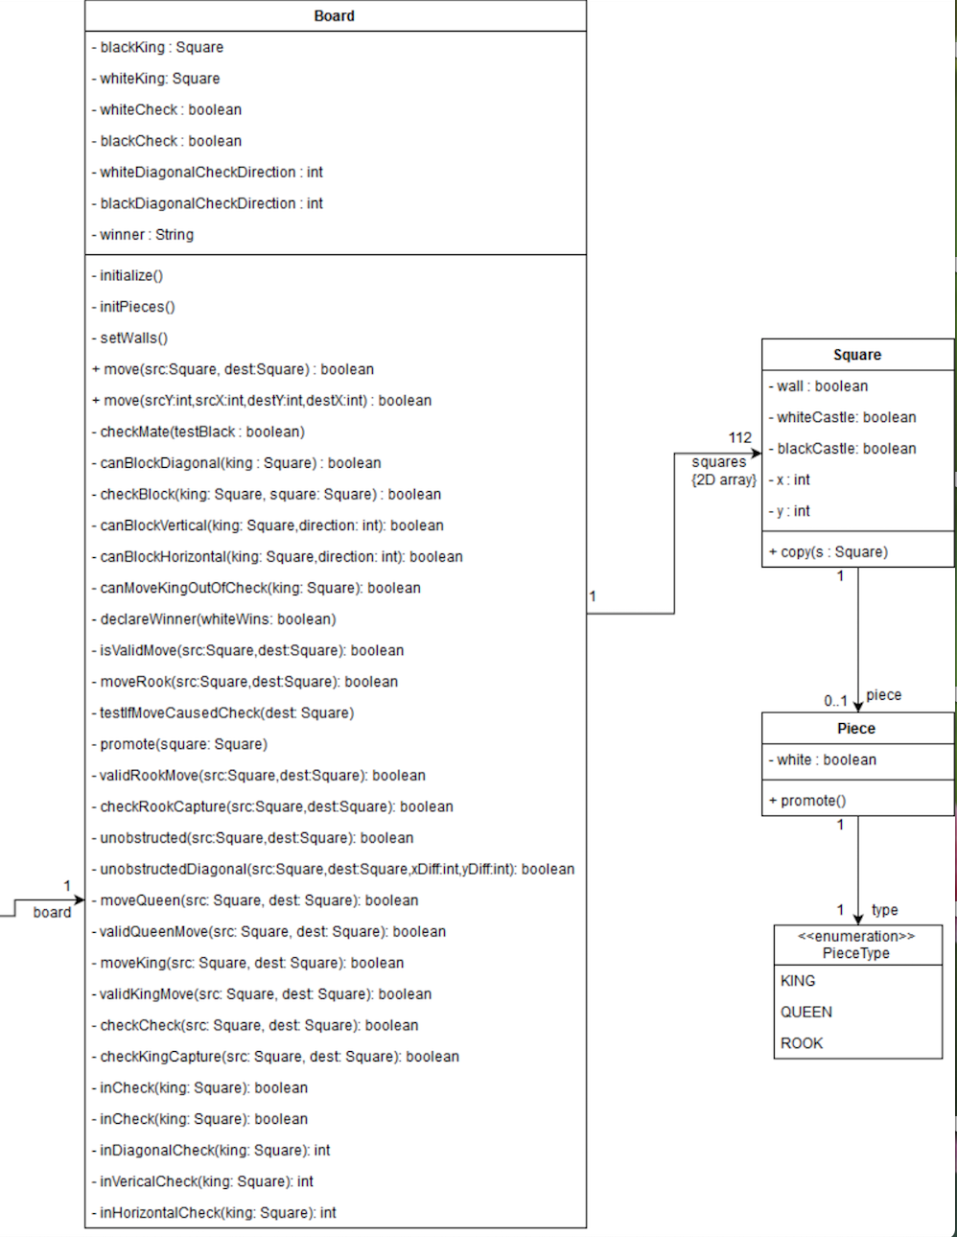
Updated design class diagram (2/2)

Slide 5
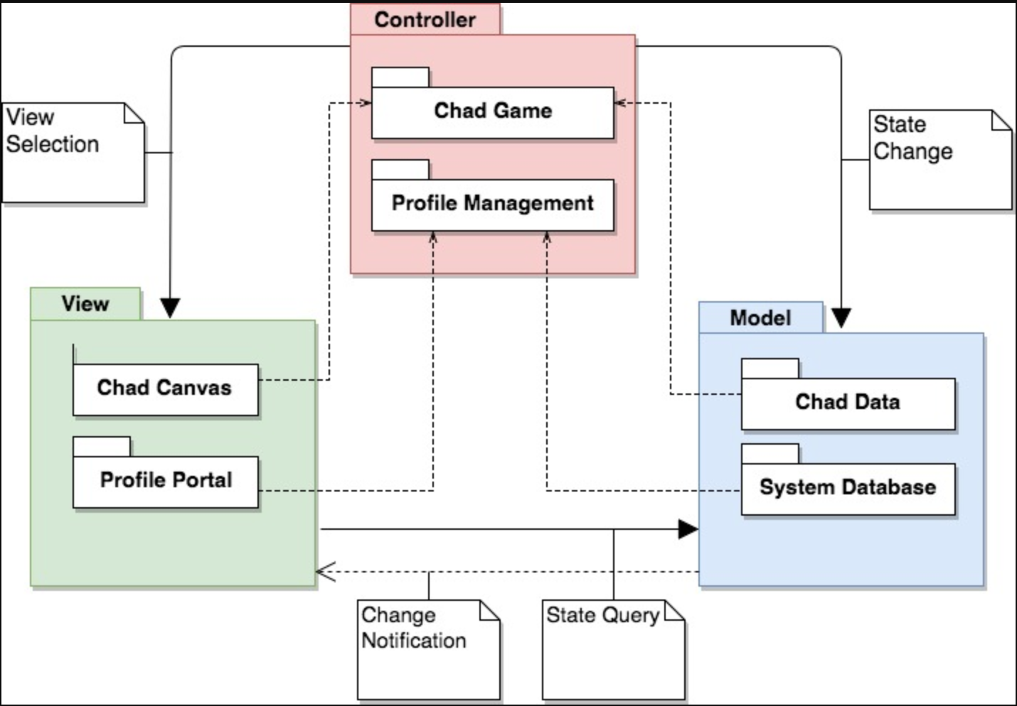
Package Diagram - logical architecture

Slide 6
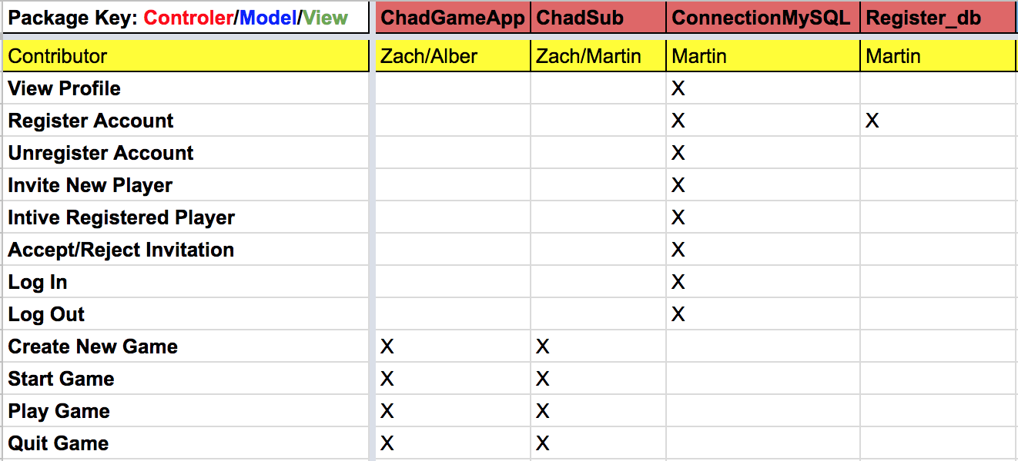
Traceability link matrix (Controller)

Slide 7
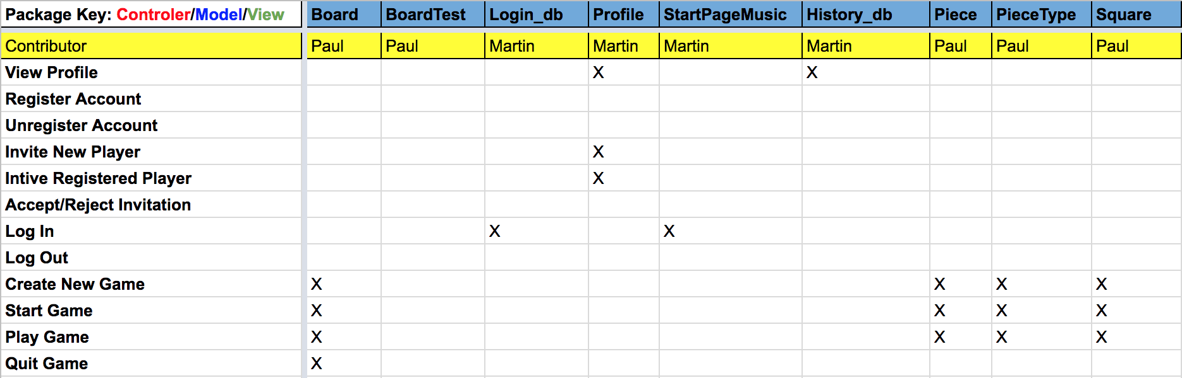
Traceability link matrix (Model)

Slide 8
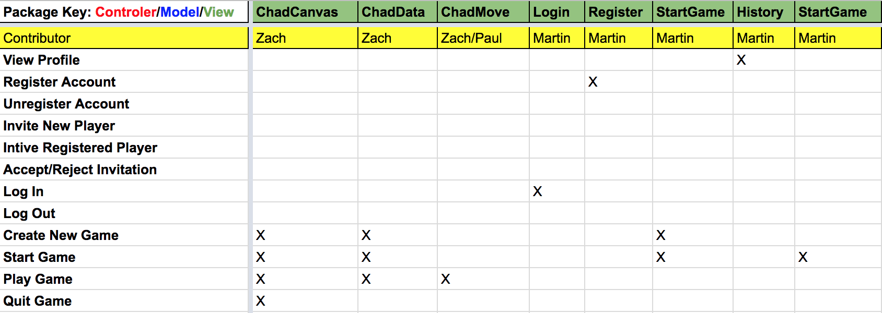
Traceability link matrix (View)

Slide 9
Refactoring and design pattern list
Board.java
Information Expert, because accesses information from multiple classes and uses it to fulfill requests
Square.java
Indirection, because it acts as an intermediate between Board and Piece
Piece.java
Low Coupling, because it has no dependencies on any other classes
ChadCanvas.java
Extract method: doMakeMove(..) extracted from doClickSquare(...)
Removed unused code
ChadGameApp.java
Move class: class moved to controller package to fit MVC

Slide 10
Refactoring and design pattern list
History.java
Move to History. java from model to view package
Move Login button actionPerformed to class Login_db
Login.java
Move to Login. java from model to view package
Startgame.java
Move to Startgame. java from model to view package
Register.java
Move to Register. java from model to view package
Move Register button actionPerformed to class Register_db
Delete gender and address information from the profile.

Slide 11
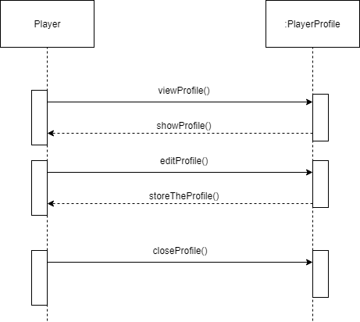
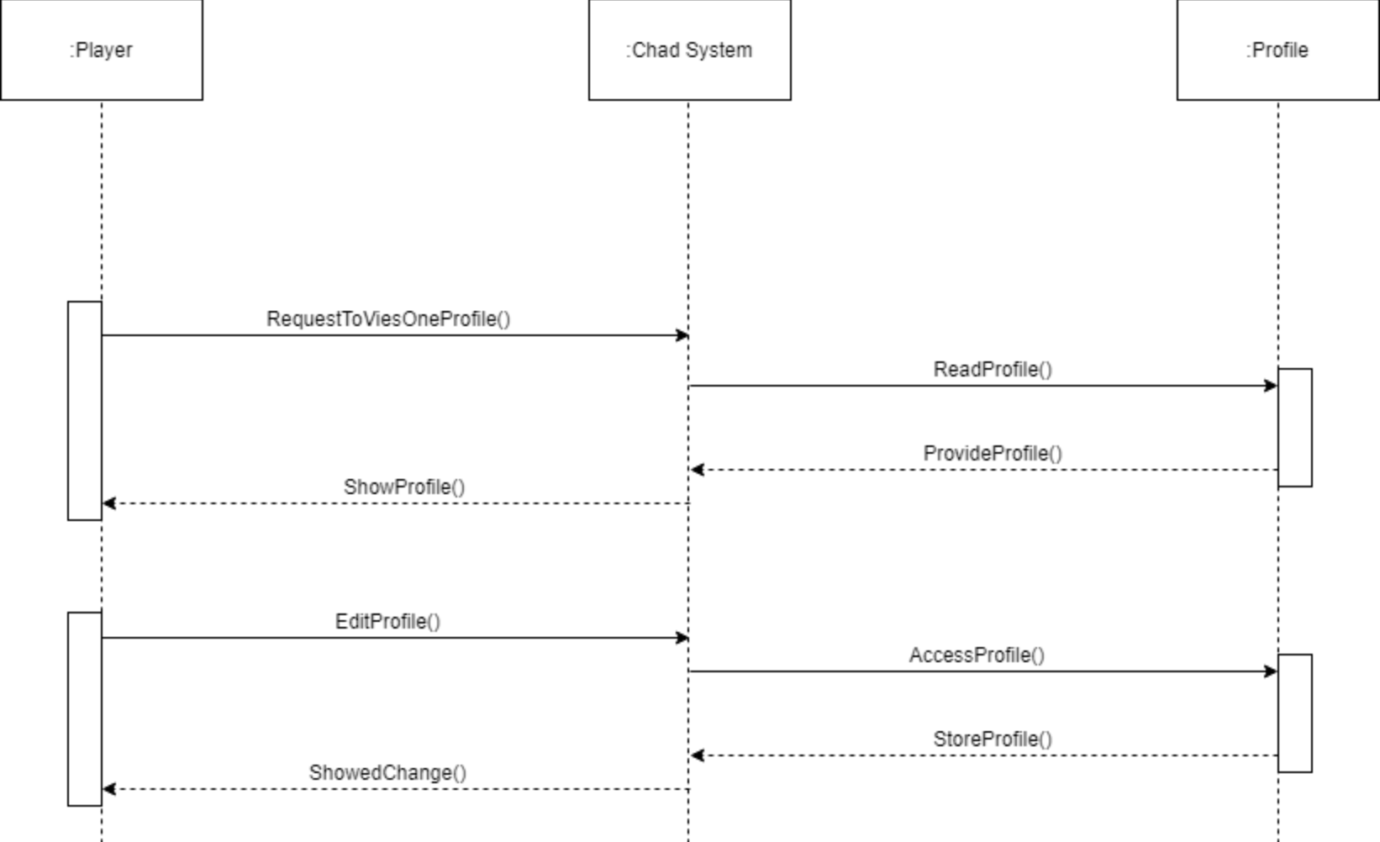
Updated Sequence Diagram 1 - Viewing Profile
Old
New

Slide 12
Sequence Diagram 1 - Viewing Profile

Slide 13
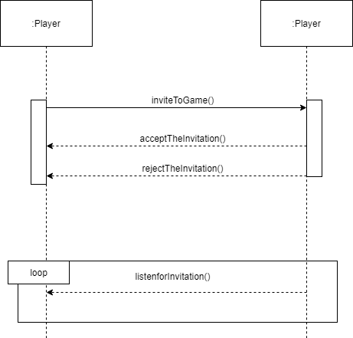
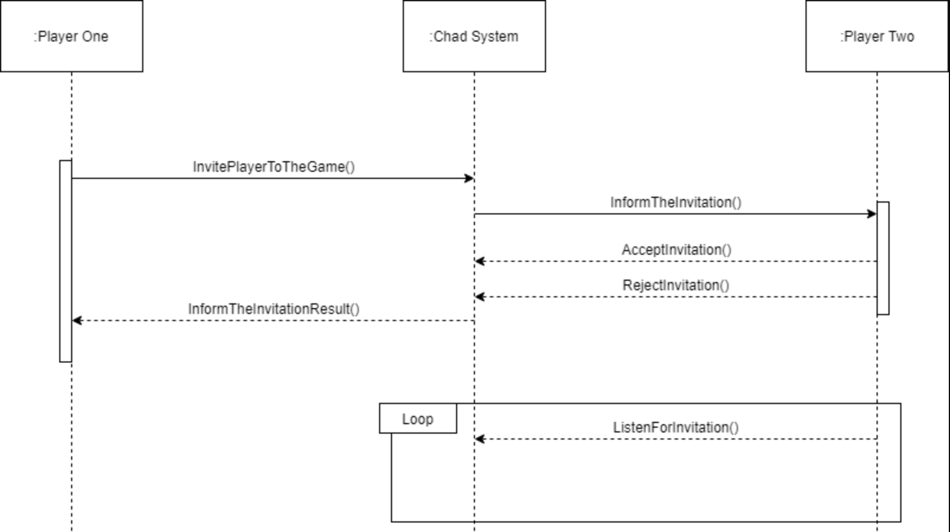
Updated sequence diagram 2 - Invitation
Old
New

Slide 14
Sequence Diagram 2 - Invitation

Slide 15
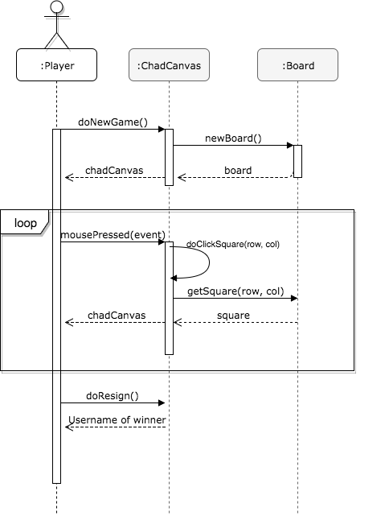
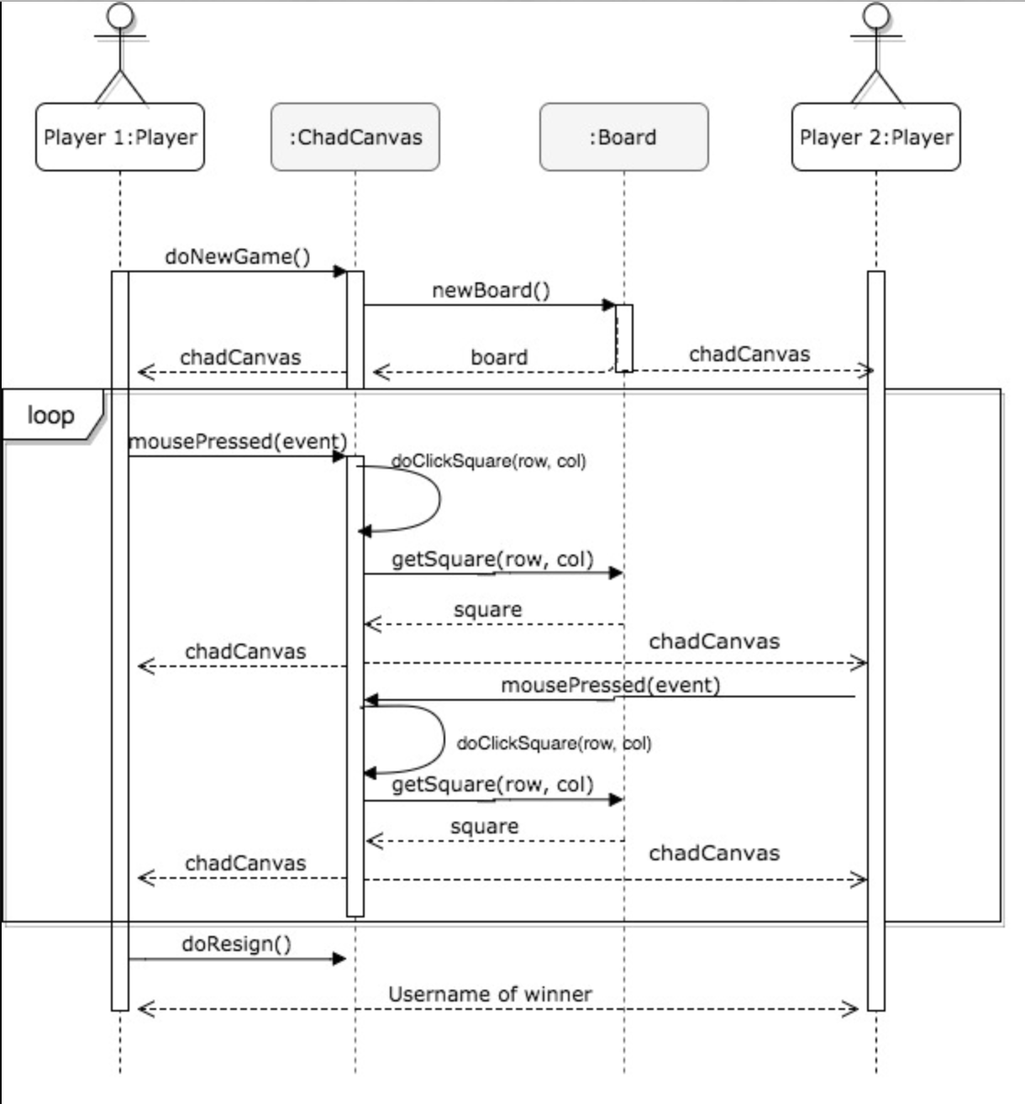
Updated sequence diagram 3 - Start & Play Game
Old
New

Slide 16
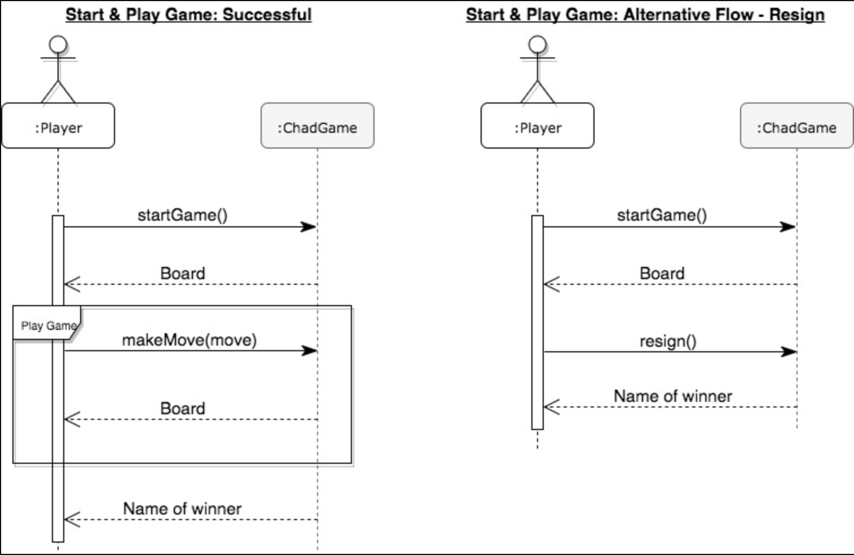
Updated sequence diagram 3 - Start & Play Game
New
Newest

Slide 17
Sequence diagram 3 - Start & Play Game

Slide 18
Demo

